Slide 1
Neural Nets & Text

Slide 2

Today’s Agenda
Natural Language Processing (NLP) Concepts
Use Cases
Quick review on bag of words approaches, etc.
Text Pre-processing Functions / Layers
This implements basic standardization and punctuation removal. It assumes 1-grams, then one-hot encodes.
No stemming or stop word removal, by default.
Architectures for Sequence Data
Recurrent Neural Networks (RNNs)
Bidirectional LSTM

Slide 3
Quick Review of NLP Concepts
Pre-processing Text
Lower-casing, stop word removal, stemming, removing punctuation, stripping rare tokens, etc.
Tokenization (this may be chars, words, sentences, etc.
Integer encoding / indexing the tokens.
Finally, I may or may not leverage sequence information.
Q: what is a bag of words approach? What are n-grams?
 | Database | SQL | Index | Regression | Likelihood | linear
D1 | 24 | 21 | 9 | 0 | 0 | 3
D2 | 32 | 10 | 5 | 0 | 3 | 0
D3 | 12 | 16 | 5 | 0 | 0 | 0
D4 | 6 | 7 | 2 | 0 | 0 | 0
D5 | 43 | 31 | 20 | 0 | 3 | 0
D6 | 2 | 0 | 0 | 18 | 7 | 6
D7 | 0 | 0 | 1 | 32 | 12 | 0
D8 | 3 | 0 | 0 | 22 | 4 | 4
D9 | 1 | 0 | 0 | 34 | 27 | 25

Slide 4
Weighting Term-Documents: TF-IDF
Not all phrases are of equal importance…
E.g., David less important than Beckham
If a term occurs all the time, observing its presence is less informative
Inverse-document frequency (IDF) helps address this.
Term ‘weighting’ is then calculated as Term Frequency (TF) x IDF
n_{j}= # of docs containing the term, N = total # of docs
A term is deemed important if it has a high TF and/or a high IDF.
As TF goes up, the word is more common generally. As IDF goes up, it means very few documents contain this term.

Slide 5
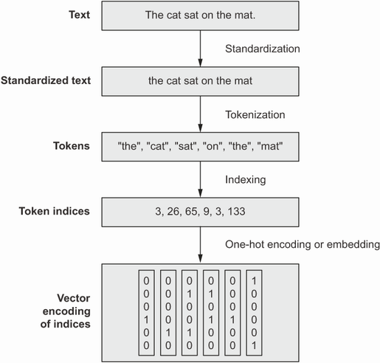
TextVectorization Layer
Pre-processing Text
Standardization, tokenization (words), one-hot-encoding / vectorization.
The Keras TextVectorization() layer achieves these steps quickly.
Customization
You can work with n-grams, and do other sorts of pre-processing, using arguments.
Options
Include as part of TF Dataset pipeline (more efficient)
Include as a layer in your Keras model.
Notes:
All text vectorization techniques generally work the same way.
We throw out words we don’t want, standardize the rest.
We then tokenize the text (split into lists of characters, words, or word-groups.
We then convert each token into some numeric vector representation (many ways we might do this).

Slide 6
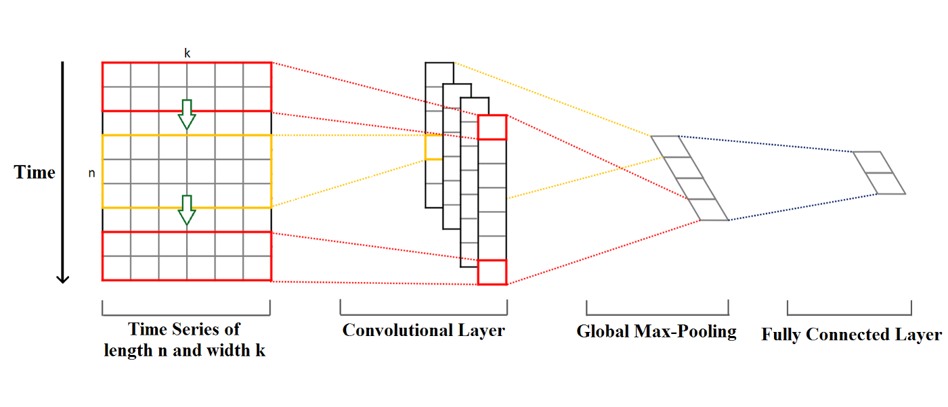
Sequence Data? We Can Do a 1D Convolution
1D Convolution Accomplishes Same Goal as 2D
It only considers arrangement of features in one dimension (temporal ordering).
Compresses into shorter sequences, across the entire set of features (just as 2D Conv compresses matrices into smaller matrices, across the entire set of input channels (e.g., RGB).

Slide 7
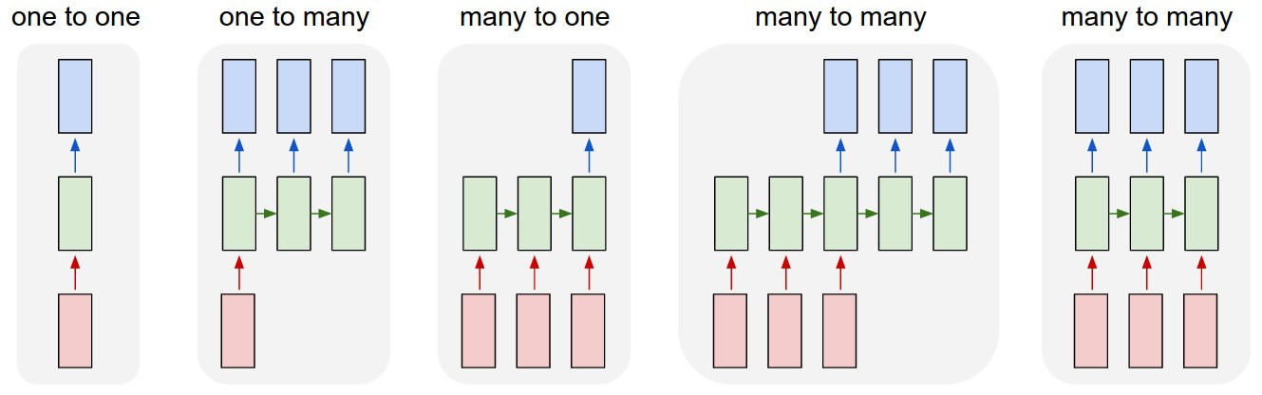
Different Types of NN Task Structures
Given what we’ve learned so far, what challenges can you foresee when it comes to ‘many-to-many’ problems?
Notes:
Image labeling, image captioning, sentiment analysis, textual translation or audio closed captioning, and, finally, something like video frame labeling

Slide 8
‘Recurrent’ Neural Network (RNN)
Keras Layer SimpleRNN
It’s a Dense layer that processes input token by token, with a feedback loop.
The inputs are arranged to interact with one another based on their temporal sequencing in the data.
In practice, we cannot use SimpleRNNs to achieve meaningful memory (vanishing gradients arise very quickly! Can you see why?).

Slide 9
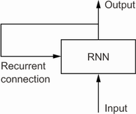
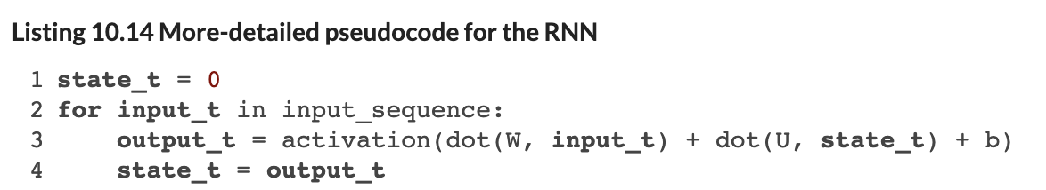
How We Often Draw This
Incorporating Memory into a NN
We include a feedback loop, where output feeds back into the same layer alongside the next input in the sequence (each gets its own separate set of weights, and they are able to interact with one another.

Slide 10
SimpleRNN: It's Just a Dense Layer
The Update Rule at Each Time Step t
h_t = tanh( W_x · x_t + W_h · h_{t−1} + b )
x_t = the current input token (e.g., the t-th word embedding in a sentence).
h_{t−1} = the hidden state from the previous step — the network's "memory" so far.
W_x, W_h, b = shared weights and bias — the same parameters at every step.
Why "just a Dense layer"?
At t = 1, there is no memory yet (h_0 = 0), so the recurrent term vanishes:
h_1 = tanh( W_x · x_1 + b )
This is identical to a single Dense layer with tanh activation. The recursion only kicks in at t ≥ 2.

Slide 11
Walking Through the Sequence
Token by Token, the Same Layer Runs Again and Again
Step 1: Read x_1 → h_1 = tanh(W_x · x_1 + b). Just a Dense layer.
Step 2: Read x_2, feed back h_1 → h_2 = tanh(W_x · x_2 + W_h · h_1 + b). Now h_2 "knows" x_1 and x_2.
Step 3: Read x_3, feed back h_2 → h_3 = tanh(W_x · x_3 + W_h · h_2 + b). Now h_3 "knows" x_1, x_2, x_3.
…and so on. After T tokens, h_T is a compressed summary of the entire input sequence.
Key Insight
The same weights W_x, W_h, b are reused at every step. The network can handle sequences of any length without adding parameters. If you "unroll" the loop, you get a deep feedforward network with shared (tied) weights.

Slide 12
Why Gradients Vanish (or Explode)
Each h_t depends on h_{t−1}. By the chain rule, each backward step multiplies the gradient by:
∂h_{t} / ∂h_{{t−1}} = tanh′(z_{t}) · W_{h}
Note: tanh′ is always between 0 and 1, so each step multiplies by W_{h} or less
Vanishing Gradients
If W_{h} is fractional it shrinks gradients:
0.9⁵⁰ ≈ 0.005
Gradient ≈ zero after ~50 steps. Model forgets early tokens.
Exploding Gradients
If W_{h} is > 1 it amplifies gradients:
1.1⁵⁰ ≈ 117
Gradients blow up. Training becomes unstable.
Notes:
Note: when gradients explode, the parameter updates become enormous. In a single training step, the weights can jump by such a large amount that the loss actually gets worse instead of better. On the next step, the gradients are even larger (because the weights are now in a bad region), so the update is even more extreme. You get a feedback loop where the loss oscillates wildly or blows up to infinity/NaN, and the model never converges. Gradient clipping is used to avoid this problem, but that means you are chopping the gradients off (removing signal), which again makes learning hard, and you’re also not addressing the underlying problem.

Slide 13
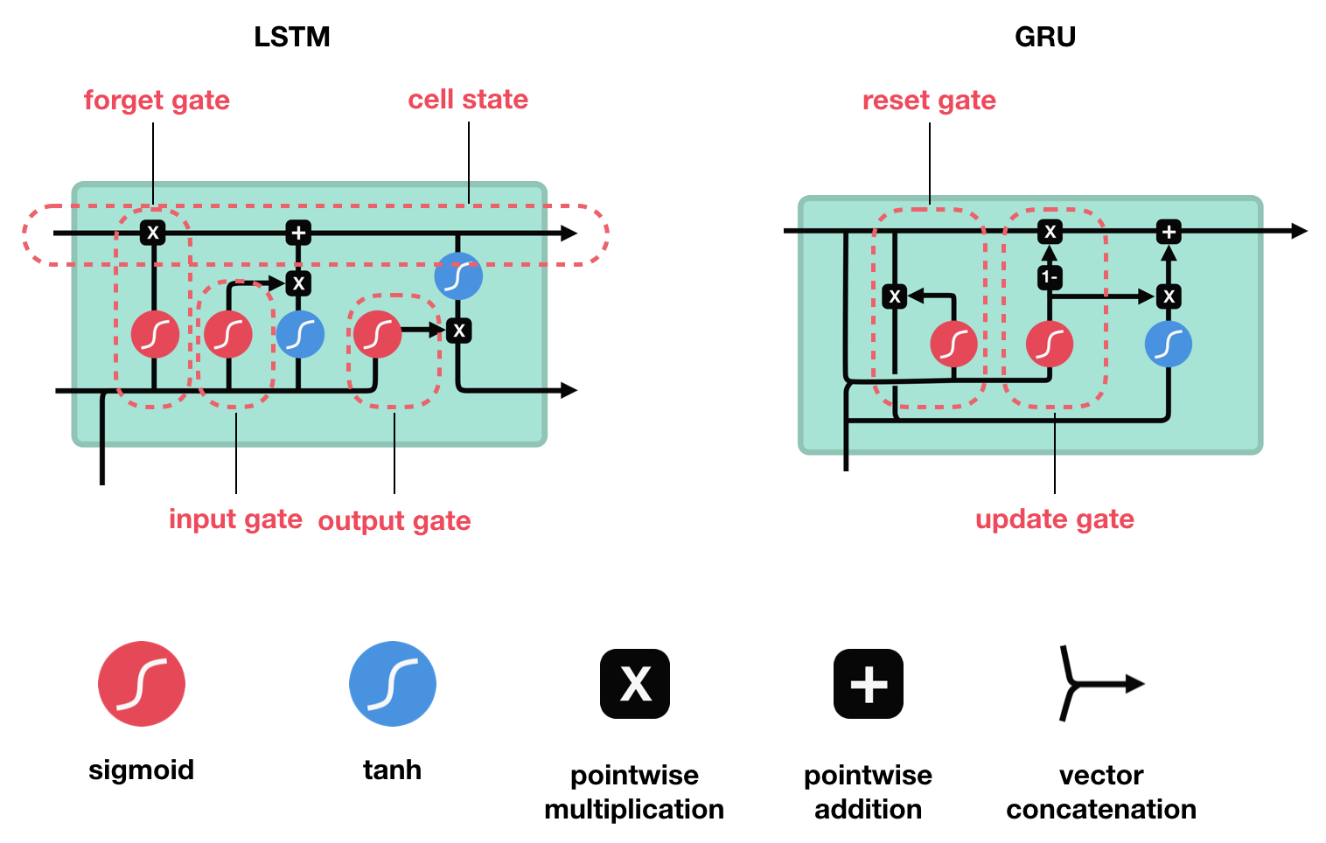
Long Short-Term Memory (LSTM)
Addresses vanishing gradient problem with a “carry track” – an additional skip / residual connection that combines output at step t, inputs at step t, and the last carry track’s output.
The topology means your network can ‘learn’ to use these connections as passthroughs for old info, or it can learn to ‘block’ that information in favor of more recent information (whatever is helpful for accurate prediction).

Slide 14
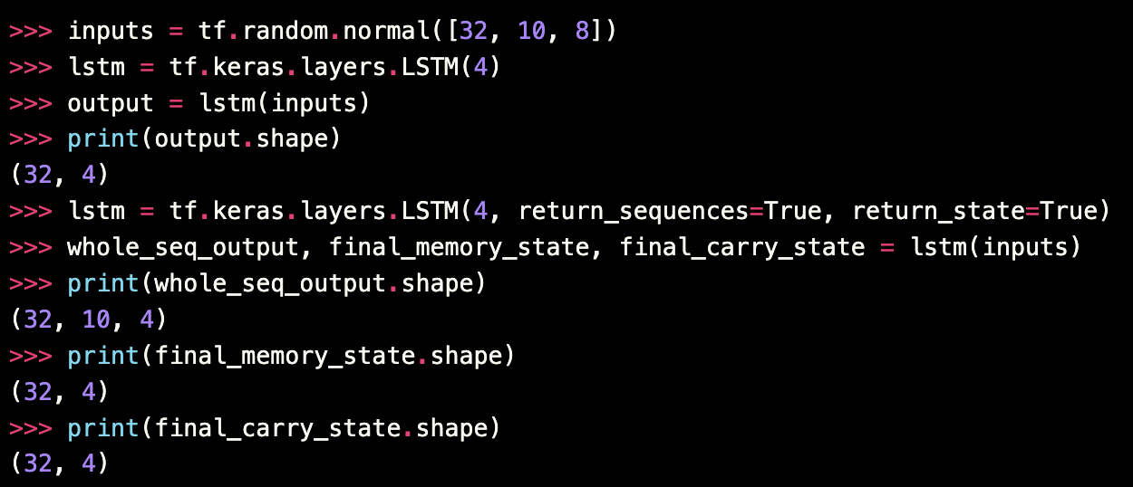
Keras RNN Layers
Long Short-Term Memory (LSTM)
Notes:
We have here a batch of 32 sequences (random values in this case), each is 10 values in length, and each value is an 8-element vector, maybe these are vector embeddings of words, I dunno. We then have 4 LSTM units, each of which will accept the input in parallel. So, each of those 4 LSTM units could be unrolled, and be seen to be taking the 10-vector sequence, separately, and learning something different about the sequence. All 4 produce a single output at the end of processing the sequence, hence why we end up with 4 outputs for the 32 observations (sequences). If we return_sequences=True, it means that every time step spits out an output, in addition to passing that output onward to the next temporal step in the LSTM. So, we end up with 10 outputs from each of the 4 LSTM units, a sequence-to-sequence mapping.

Slide 15
Keras RNN Layers
Gated Recurrent Unit (GRU)
Less complex than an LSTM. Combines elements of the LSTM into simpler gated structure.
Fits more quickly, with less data, but memory tends to be shorter.
More common in NLP tasks, e.g., because “within sentence” or “within paragraph” memory is often sufficient.

Slide 16
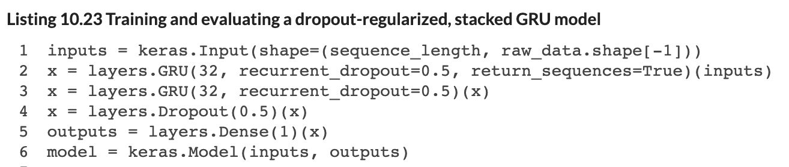
Stacking RNN Layers
Stacked Layers (LSTM or GRUs)
Same as other ‘layer’ types, but we need to pass the entire sequence of outputs (not just the last output). We do this with the ‘return_sequences=True’ argument to the layer.

Slide 17
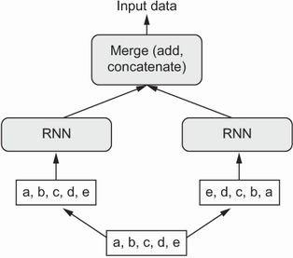
Bidirectional RNNs
Some Sequences Yield Information in Both Directions
Consider that, in language, words that come later in a sentence can be predictive of what came before.
Bidirectional RNNs implement a standard RNN, but they also incorporate a parallel layer implementation that takes the sequence ordered in reverse.

Slide 18
Why Do We Need RNNs Though?
Some Notable Differences Between RNNs and Transformers
RNNs can stream output immediately, as the input arrives, whereas a vanilla transformer needs to see the full context/sequence before producing output.
Transformers tend to be larger neural networks, with more parameters (they excel when they are big).
Where RNNs Excel
Latency! If I need to stream real-time audio (e.g., hearing aids) or real-time closed captions, or robotics applications, etc., then delays are the enemy.
Edge devices! If I need the ability to use one of these models on-device (e.g., somewhere that lacks internet, or that is privacy sensitive) then it’s hard to host a large neural network that has high inference time/costs.
RNNs have fixed weight matrices that are shared across tokens in the sequence; Transformers require bigger attention matrices as sequence lengths grow.

Slide 19
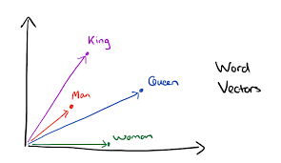
Embedding Layer
With Hot Encodings, Model Will Still Struggle to Figure Out Semantics
Despite having sequence, the model is “told” that the tokens are orthogonal / independent of one another in their meanings. But that’s not true!
Textual Embedding Layer First Provides Dimensionality Reduction
Represent words into a lower dimensional space – similar vector = similar meaning.
The Embedding layer is a lookup table that maps tokens to vectors. For each token in the vocabulary, the network learns a vector representation. The vectors are initially random, and the network updates them in training to learn representations that help in prediction (just like with convolution filters!).
In practice, it is learning semantic relationships…
This is much better for an RNN than a hot encoding, because 120 values (for example) is << 20,000!
Notes:
Available pre-trained embedding layers (e.g., trained on Wikipedia page data), but you can also fit these models on your own corpus of text, to learn context-specific embeddings.

Slide 20
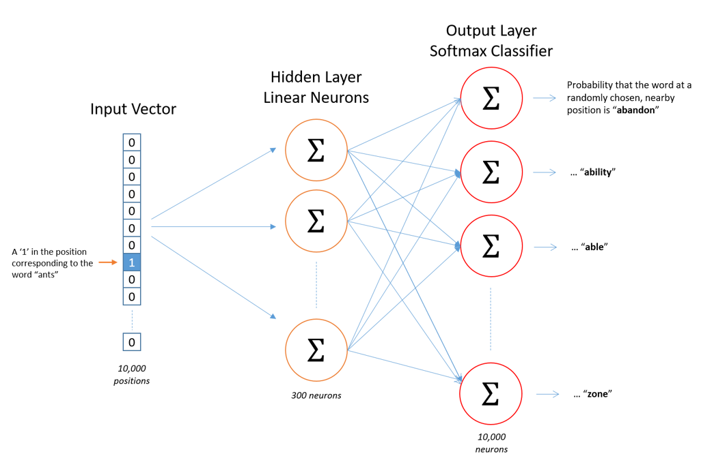
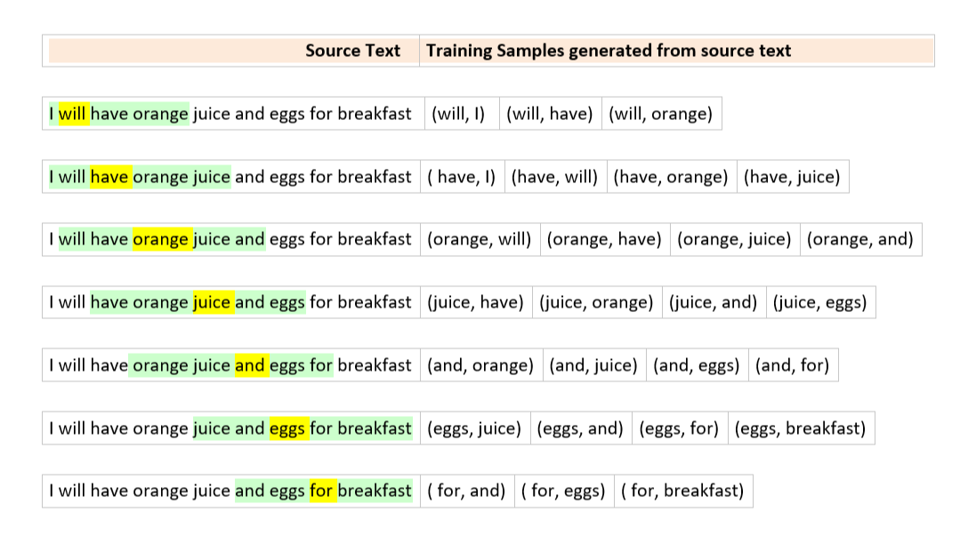
Pre-Trained Embeddings: Word2Vec
Word2Vec
Two types: CBoW and Skipgram
Construct training examples and labels.
Notes:
This is skipgram on the right. One word to surrounding context words (we map input word to

Slide 21
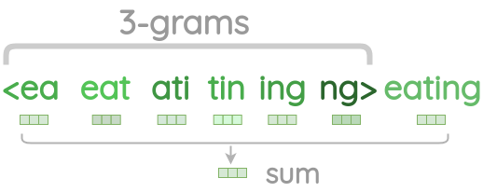
Pre-Trained Embeddings: Limitation
Out of Sample Words
Both GloVe and Word2Vec are limited to words you’ve seen before in training. They cannot handle new words. Those words thus get omitted / dropped, or you need to do something different.
FastText
An extension to Word2Vec which learns character n-grams of words. So, instead of embedding words, we embed portions of words (e.g., a 3-gram character representation would break up the word ‘coffee’ into ‘cof’, ‘off’, ‘ffe’, … and then learn vector embeddings of each.

Slide 22
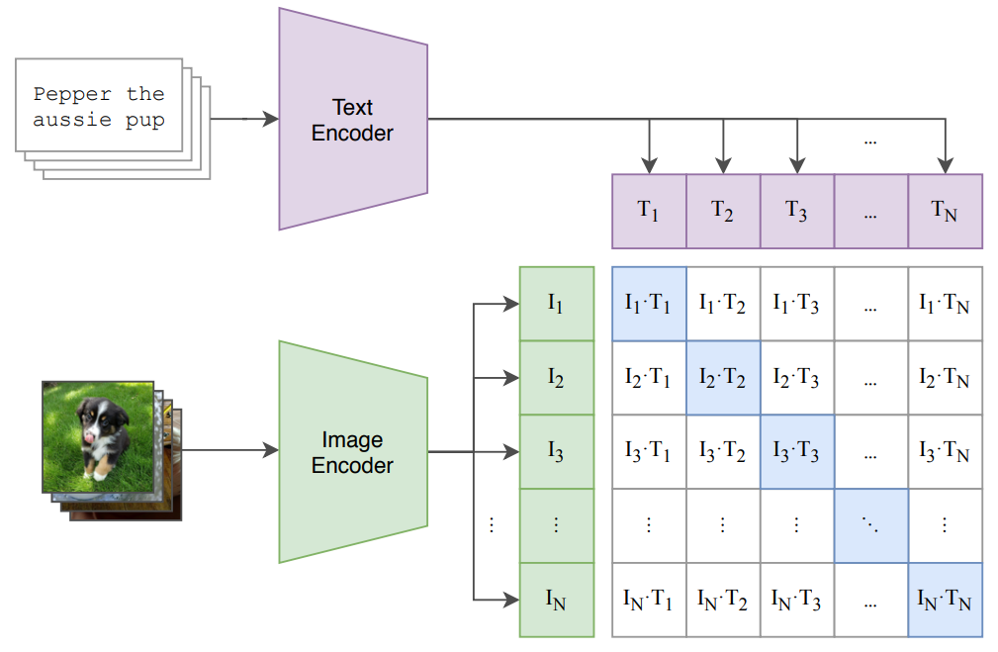
Contrastive Language-Image Pre-training (CLIP)
Notes:
Each observation is a ‘set’ of images and a set of captions. We train the model to predict which image goes with which caption, but we don’t actually care about the predictions. It’s a throw-away aspect of training. The resulting model learns highly informative (much more informative than before) representations of images in a vector space, a vector space that is also shared by text embeddings. We can map text to images, and images to text, quite accurately.

Slide 23

Contrastive Loss
The goal here is *not* prediction. The goal is to train a model that can encode inputs into numeric vector representations in a shared embedding space, such that ‘similar’ vectors are conceptually related, and ‘dissimilar’ vectors are conceptually unrelated.
We have a special loss function that we minimize for this purpose, where it is once again a 2-part loss, depending on whether the ‘pair’ of inputs is positive (related) or negative (unrelated).

Slide 24
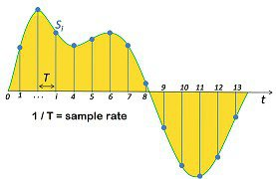
RNN for Audio
Same Sequence Concepts Work for Audio Data
Audio files are just sequences of numeric values (amplitude), possibly two if it was recorded in stereo.
Once we recognize this, we realize we can predict things about audio sequences too!

Slide 25
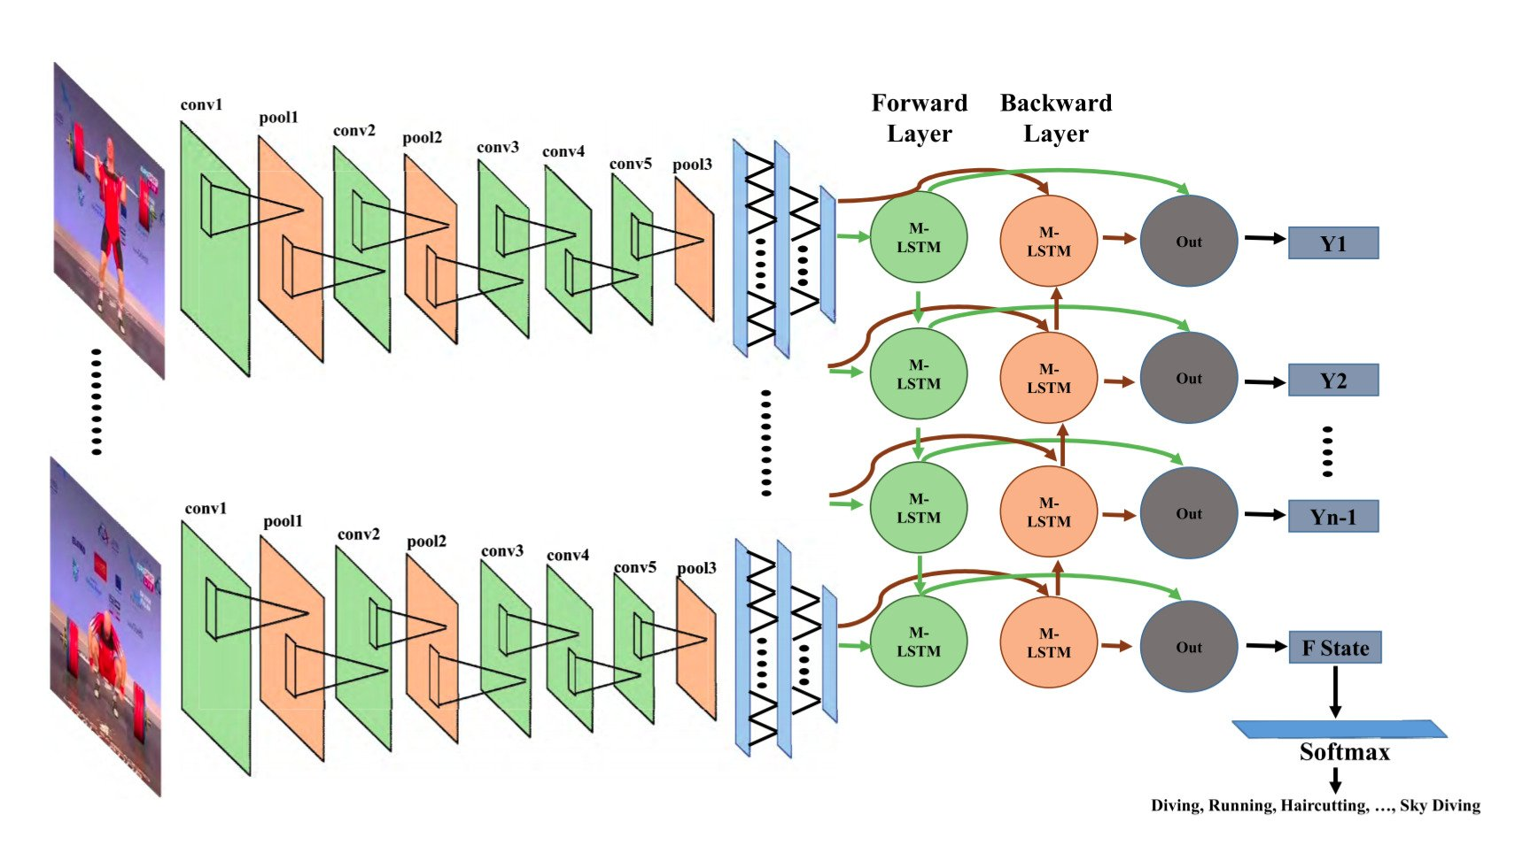
CNN-RNN for Video
Hybrid Topology for Image Sequences
We Use CNN’s to detect features at a given input.
We feed those feature maps into an RNN architecture, like LSTM.
We can use this topology to predict things about videos.
You might pre-process frames using a pre-trained CNN and pass feature maps as sequences to an RNN.
Notes:
This is skipgram on the right. One word to surrounding context words (we map input word to

Slide 26
Questions?

